Slide 1
Bike Sharing Demand Analysis
Project using Excel
Name:
Om Prakash

Slide 2
Content
Introduction
Problem statement
Data description
Data Prepration
Data merging
Data Analysis
Correlation analysis
Standard deviation analysis
Dashboard overview
Visualisation
Charts
Business Recommendation

Slide 3
Introduction
This project analyzes bike rental demand using Excel.
Focus: weather condition, time, humidity, windspeed, Temperature, weekday and holidays .
Look for patterns over time and how weather changes affect rentals.
This project uses Excel tools to clean and join data, visualize trends, create new features, and prepare easy-to-understand reports.
Organized data leads to better decisions faster.

Slide 4
Problem Statement
Understand factors affecting bike rentals
Identifying impacts of weather , time and holidays
Help improve business decisions and planning

Slide 5
Dataset Description
Three datasets Dataset1, Dataset2, Dataset3 merge on common keys i.e. Instant via Power query
Data Includes: date, hour, weather, weekend, weekday, users, rentals count

Slide 6
Data Preparation
Data cleaning
Handle missing values
Formatted date and numeric fields
Sorting and filter inconsistent data
Standardized data format

Slide 7
Data Merging
Used Power Query
Merged datasets using common keys : Instant
Three datasets Dataset1, Dataset2, Dataset3
First merge dataset1 and dataset2 to get dataset A.
Then dataset A append dataset3 to get final dataset.

Slide 8
Data Analysis
Used Pivot Tables , Pivot Charts
Analyzed trends by hour, weather, weekend, Temperature, Humidity, Windspeed, Atemp and temp
Use COUNTIF, SUMIF, STDEV, CORREL functions for statistics.

Slide 9
Correlation analysis
Variable vs Count | Correlation | Insights
Hours vs Count | 0.366047 | Moderate positive, Time has impact on a rental as at certain hours rental got incresed. Most impactful factors compare to others.
Temp vs Count | 0.229292 | Weak positive, as temperature increase rental increase little bit but it doesn’t have strong impact.

Slide 10
Standard deviation analysis
variable | standard deviation | Insights:
Temp | 0.053079104 | data is high consistant, which means temperature is stable not much fluctuation.
Humidity | 0.100516781 | data is low consistant, which means humidity has little variation.
Count | 59.08701518 | data is highly scattered, which means rental have the high variation and doesn’t the stable demand.
Hours | 6.899100564 | data is scattered, which means rental demand have depend on hours varition just like peak hours at high demand on rental bike .

Slide 11
Data visualisation & Dashboard overview
Build interactive dashboards combining multiple charts (line, bar, donut etc).
Add slicers and timelines for filtering dashboards dynamically.
Hourly demand trends and Weather impact analysis

Slide 12
Business Recommendations
Increase bikes rental in peak hours
Adjust pricing by demand
Focus on weather trends
Key Findings:
Higher demand in good weather
Peak during office hours
Weekend patterns differ

Slide 13
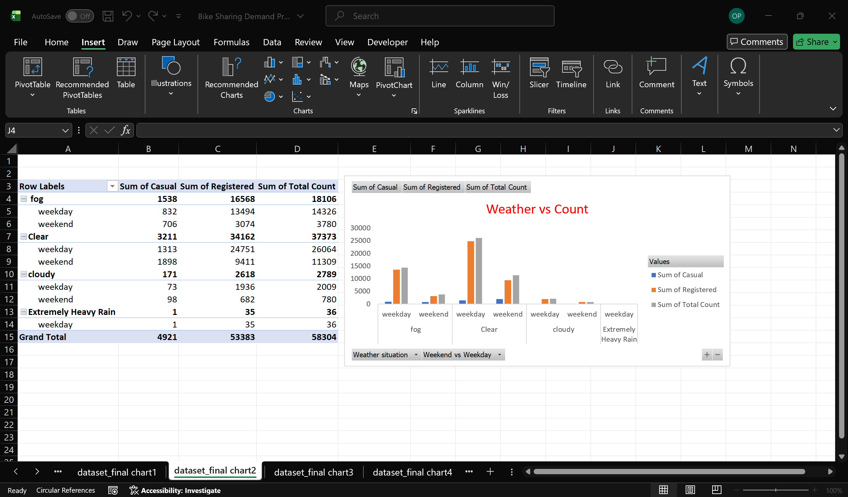
Weather vs Count
Bike demand is highest in clear weather, especially on weekdays, while it decreases in cloudy and rainy conditions. Extremely heavy rain shows almost no usage, indicating weather has a strong impact on bike rentals.

Slide 14
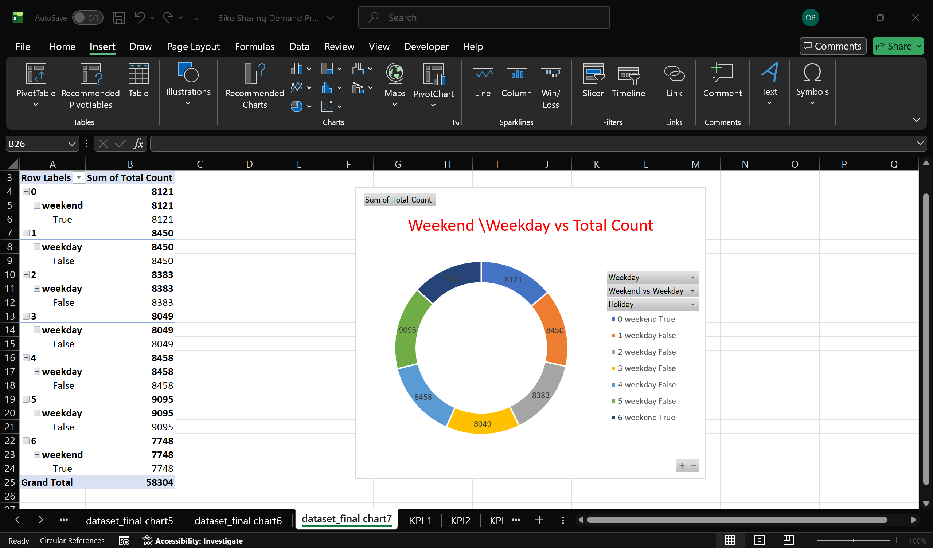
Weekend \Weekday vs Count
Bike demand is higher on weekdays compared to weekends, showing strong commuting usage. Weekends have relatively lower demand, indicating more leisure-based but limited usage.

Slide 15
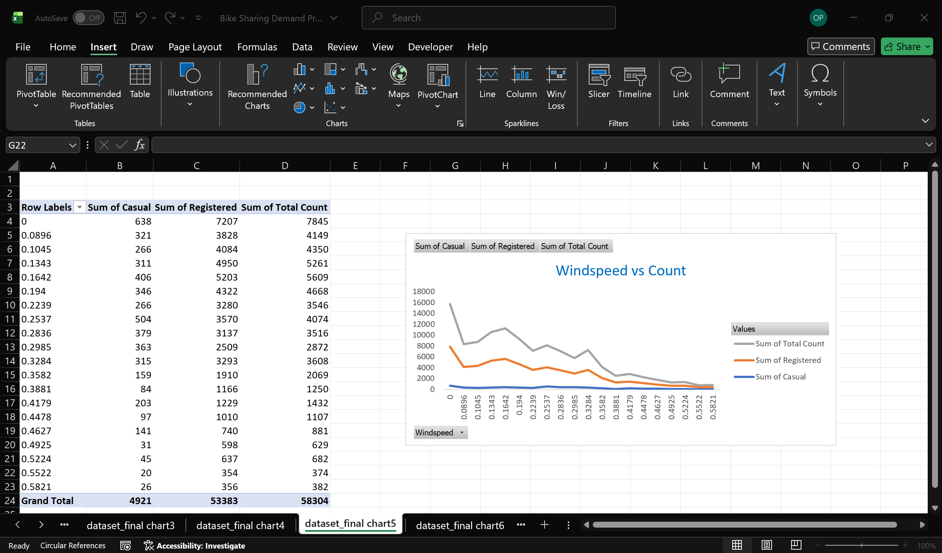
Windspeed vs Count
Insights:
Bike demand decreases as windspeed increases, showing people avoid riding in windy conditions. Highest usage is seen at low windspeed, especially among registered users.

Slide 16
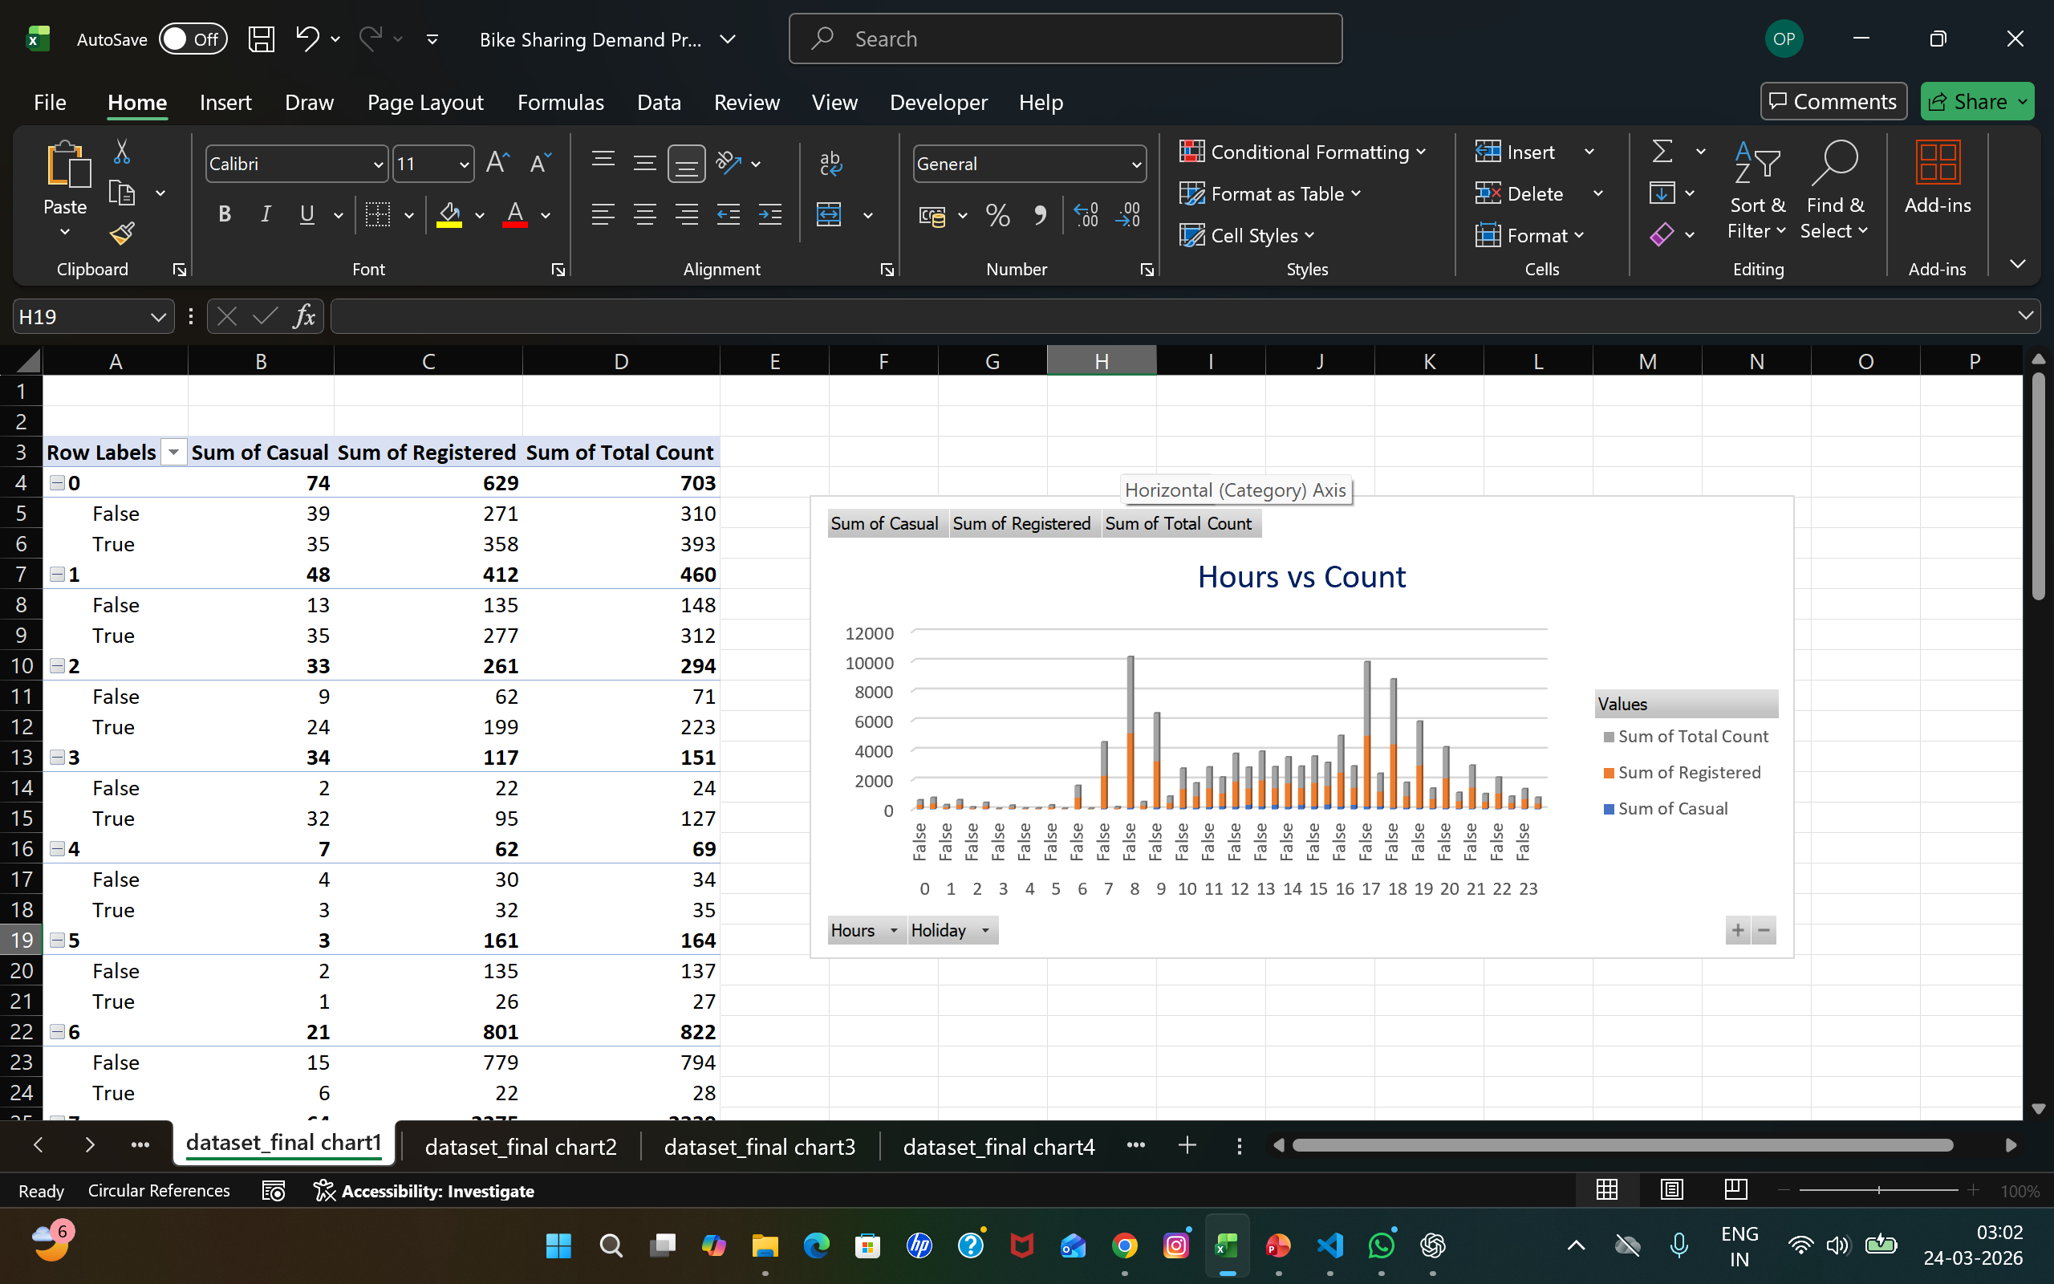
Hours vs Count
Key Insights:
1. Peak Hours 🚴‍♂️
Demand is highest around 7–9 AM and 5–7 PM
This indicates office commute patterns
2.In holidays Peak hours , demand is highest around 12-4 PM
👉 Registered users dominate here → daily commuters

Slide 17
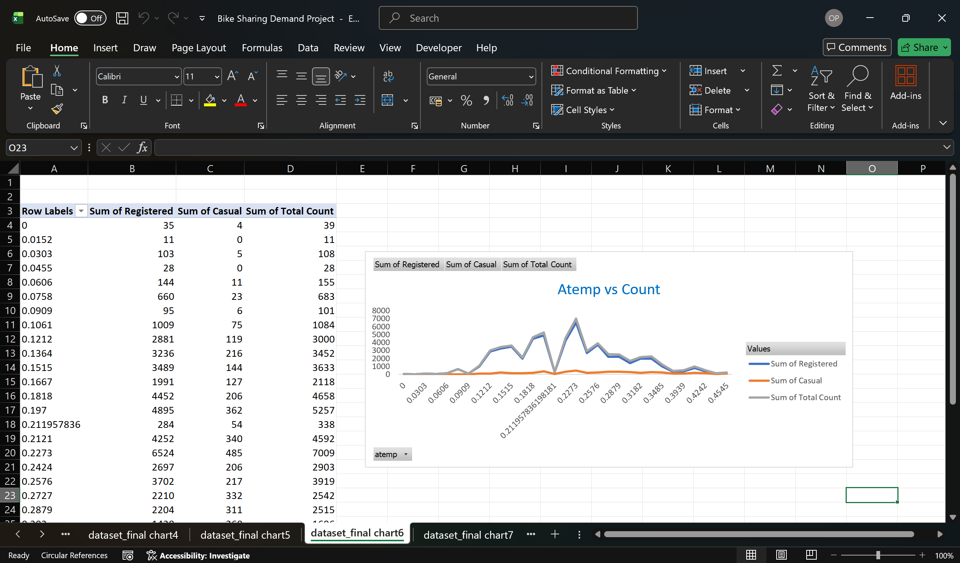
Atemp vs Count
Key Insights:
As atemp (assume temperature) increases , registered and total count increase with a peak of moderate temperature

Slide 18
Thank You

